Slide 1

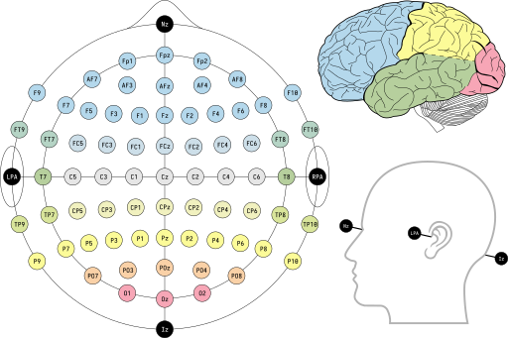
Localising the onset of face sensitivity in EEG time-series
Peter Hebden
Supervisor: Dr Guillaume Rousselet
12/8/2024
Image: Laurens R. Krol - Own work, CC0, https://commons.wikimedia.org

Slide 2
Outine
Introduction​
Dataset​
Aims​
Methods​
Results​
Conclusion

Slide 3

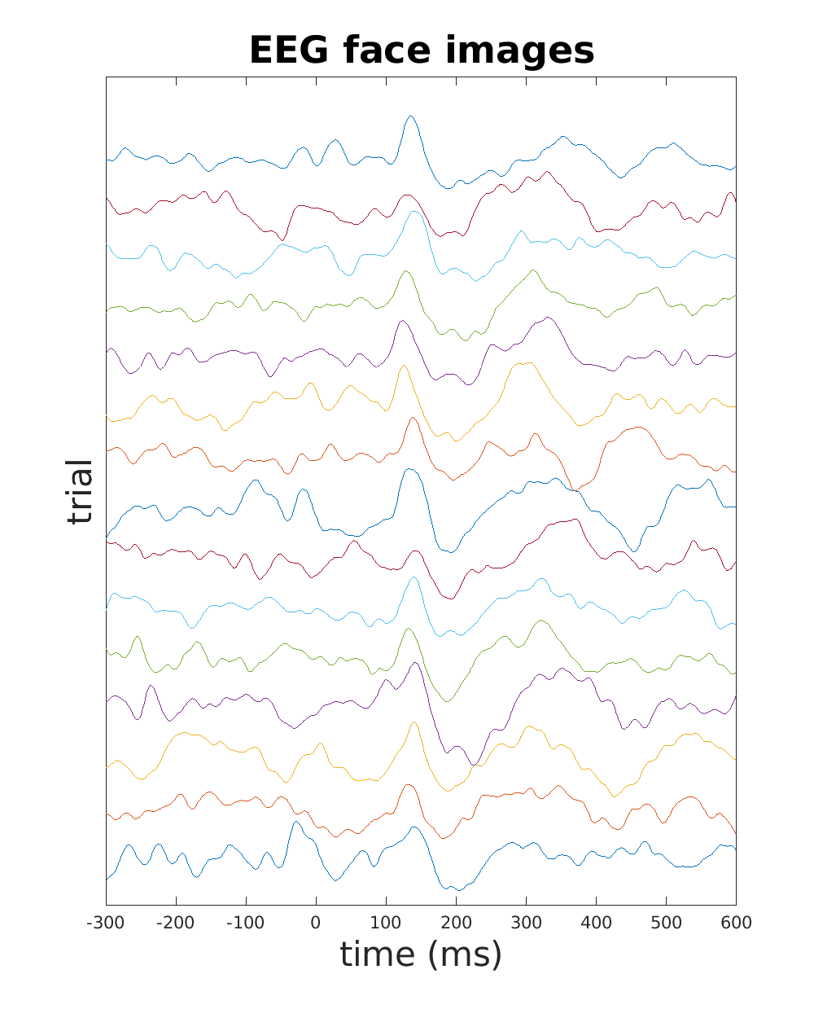
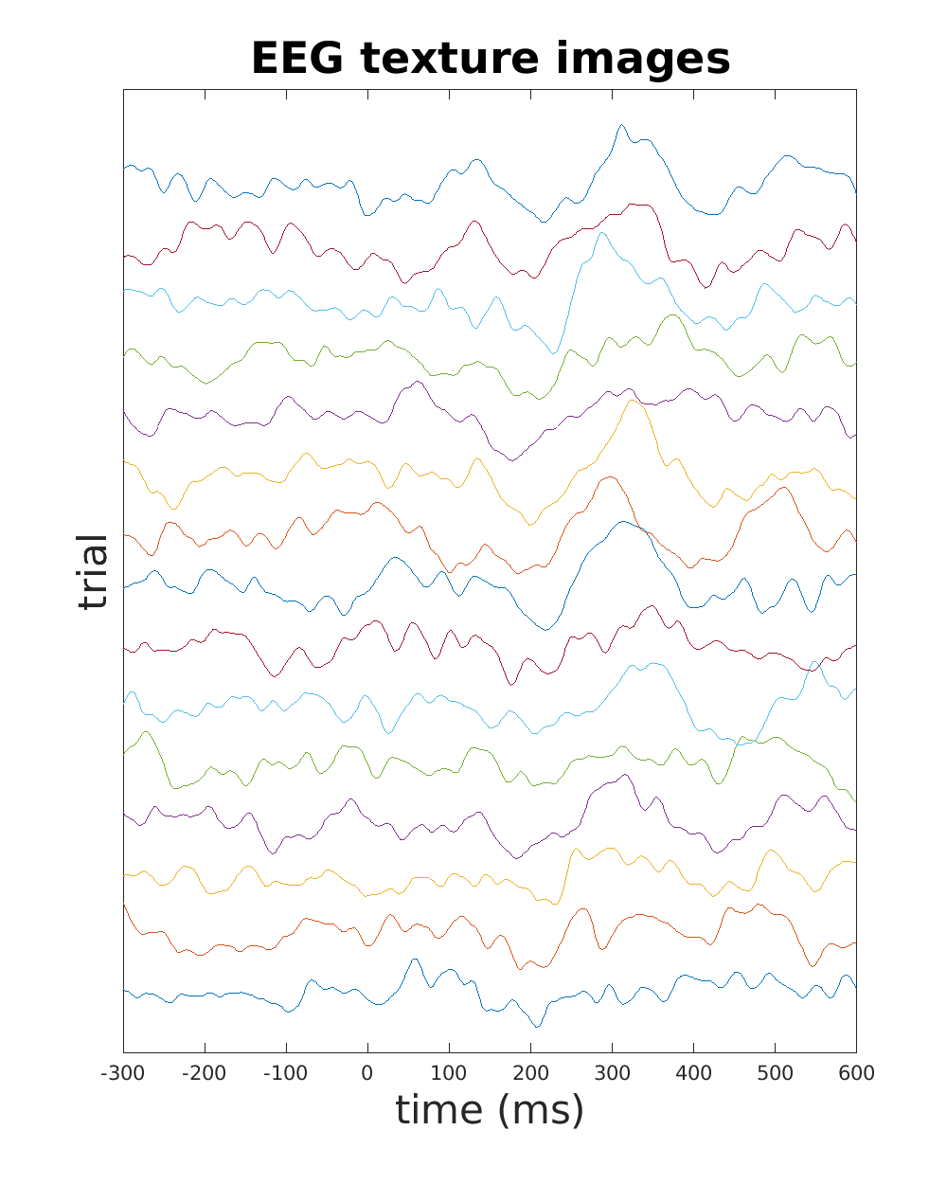
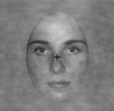
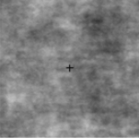
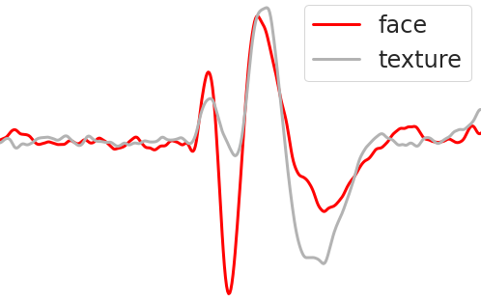
Introduction: EEG time series recorded during trials

Slide 4
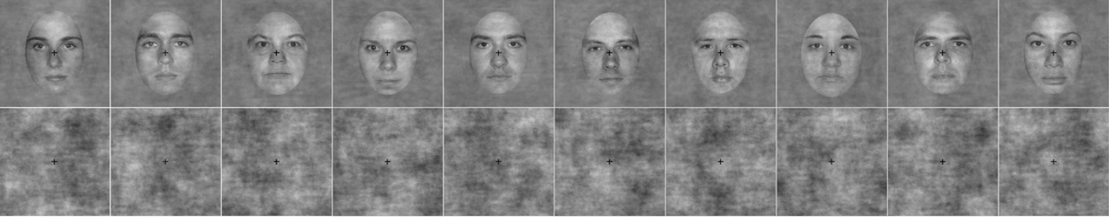
Dataset
Image: Rousselet, et al., 2014)
The dataset of EEG recordings:
75 participants shown face and texture images,
each image presented for 104ms,
during two sessions,
up to 150 trials, and
up to 128 electrodes (Bieniek et al., 2016).
​

Slide 5
Aims
Detect face sensitivity ERP onset time from EEG recordings.
For each participant and each session:
Evaluate methods for onset detection:
cluster-based methods
change point detection methods
Evaluate impact of a data dimensionality reduction technique that builds a virtual electrode.

Slide 6
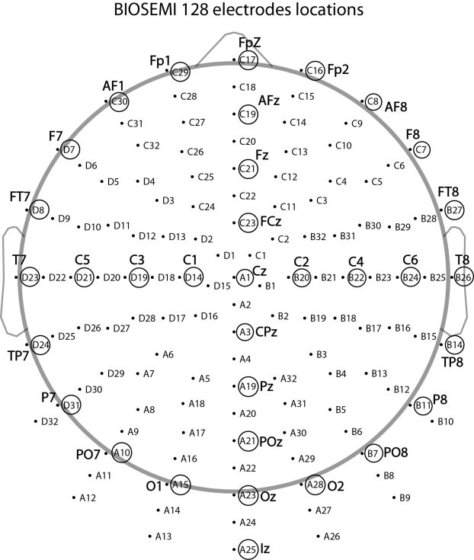
Methods: cluster-based
Spatio-temporal cluster-based methods
Cluster adjacent electrodes and time points (Bieniek et al., 2016).
Temporal cluster-based methods
Cluster adjacent time points.
Uses a virtual electrode of maximum t² values (Rousselet, 2014).
Both methods
Computationally expensive
1000 permutations of every face and texture pair of trials.
Use the cluster-sum method to detect the ERP onset.
cluster-sum: a non-parametric statistical test (Maris & Oostenveld, 2007)
Notes:
Both methods
Computationally expensive
Use the cluster-sum method to detect the ERP onset
cluster-sum: a non-parametric statistical test (Maris & Oostenveld, 2007)
1000 permutations of every face and texture pair of trials
E.g., ~12.9 hours to estimate 150 onset times for the participants

Slide 7
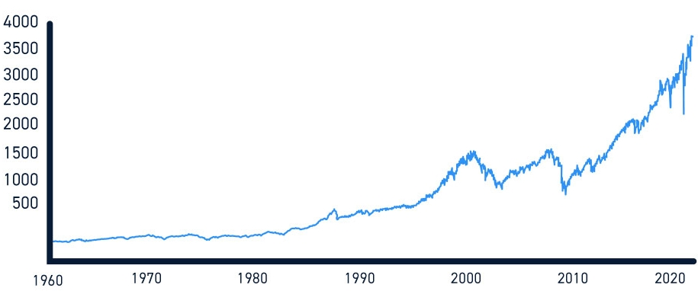
Methods: change point detection (CPD)
General purpose methods for detecting where an underlying process changes over time.
S&P 500 index
GFC
Why CPD methods?
Fast (seconds or minutes)
They do not use 1000s of permutations.
Can set number of change points.
Our data: one change point of interest.
Why not cluster-based methods?
Slow (hours)
Simulations have cast doubt on their accuracy (Sassenhagen & Draschow, 2019) .
CPD methods have been suggested as an alternative (Rousselet, 2023).
Binary segmentation (Scott & Knott, 1974).
Other CPDs: Pelt, Window-based, Dynamic Programming, and BottomUp (in Python).

Slide 8
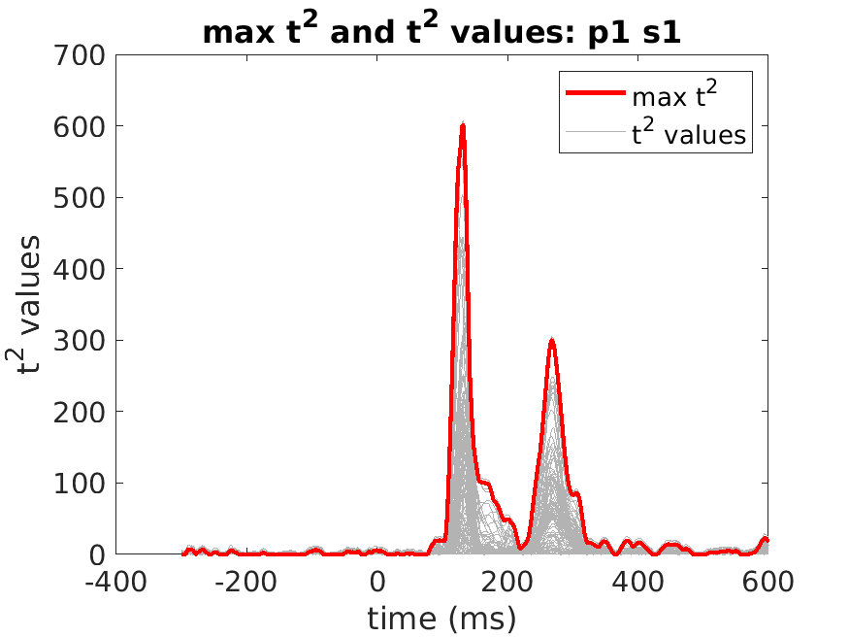
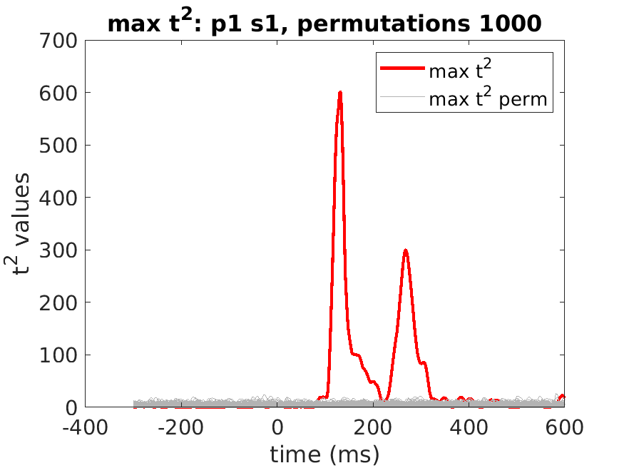
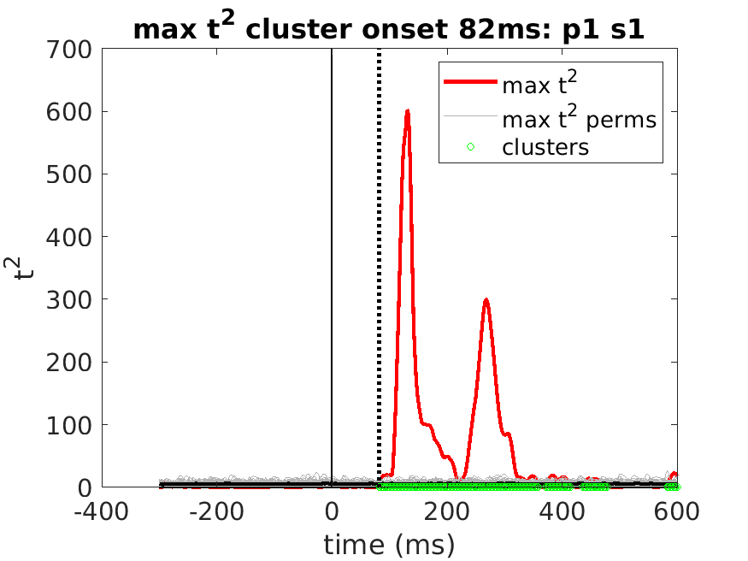
Methods: participant virtual electrode
From the max t² electrode
onset
participant VE
perms
Build a participant virtual electrode:
(1) t-test at each time point across all
electrodes.
(2) save ID of the max t² electrode
for this participant.
Use permutations:
(1) define t² threshold for time points.
Build clusters:
(1) Find clusters of time points where
t² > threshold.
(2) Sum t² values for each cluster.
(3) Onset: 1st time point in 1st cluster
with cluster-sum > threshold.

Slide 9
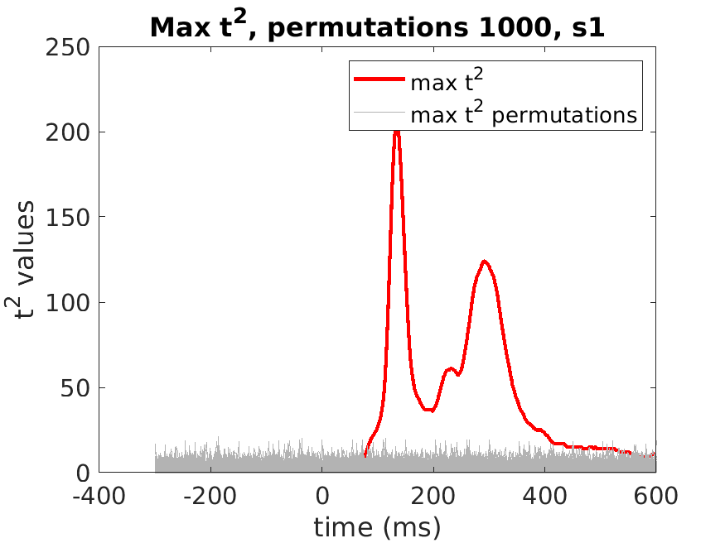
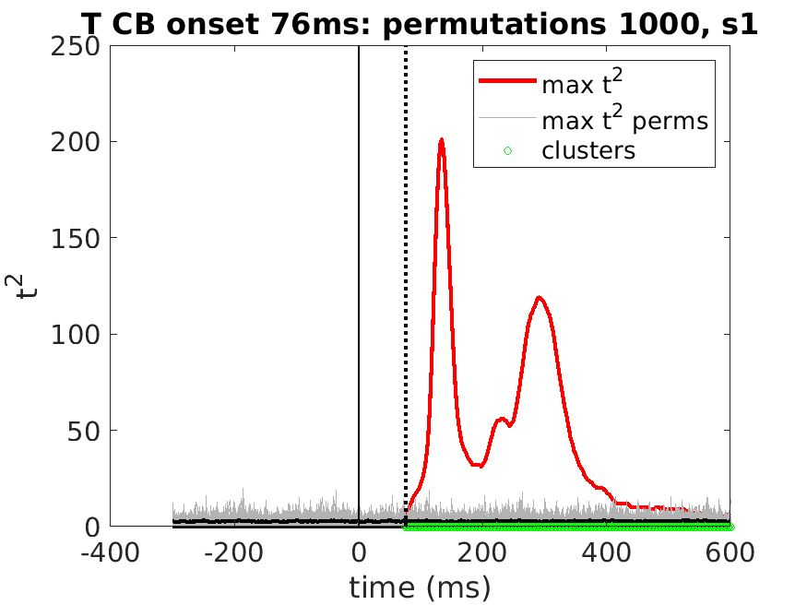
Methods: session virtual electrode
session VE
onset
Build a session virtual electrode:
(1) Use the average ERPs from the max t² electrodes.
(2) Use permutations to set thresholds.
Build and test clusters:
Build clusters from adjacent t² > threshold.
Find clusters with cluster-sum > threshold.
First time point in first significant cluster
is the ERP onset.

Slide 10
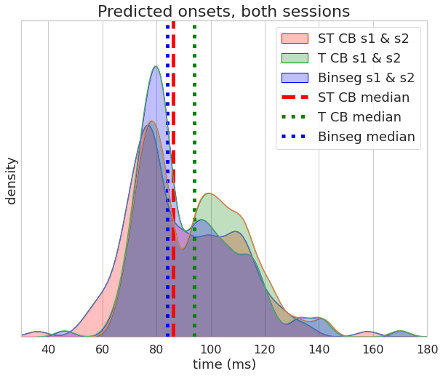
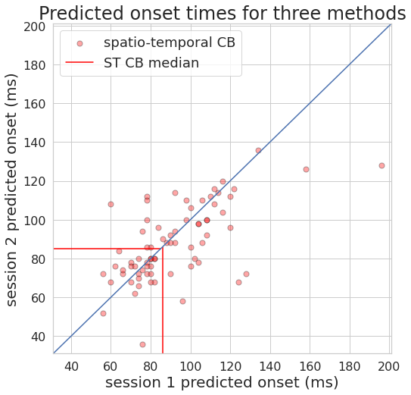
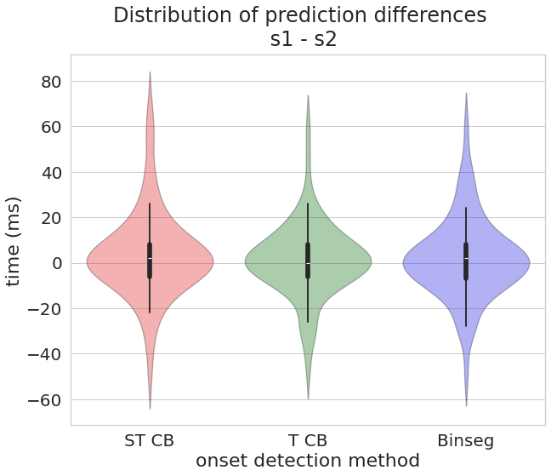
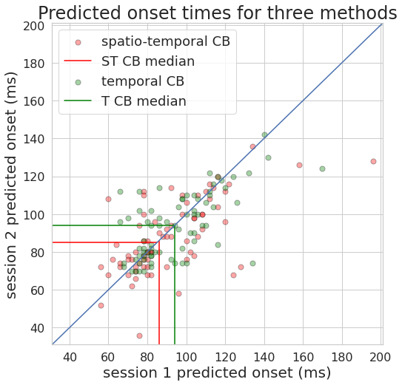
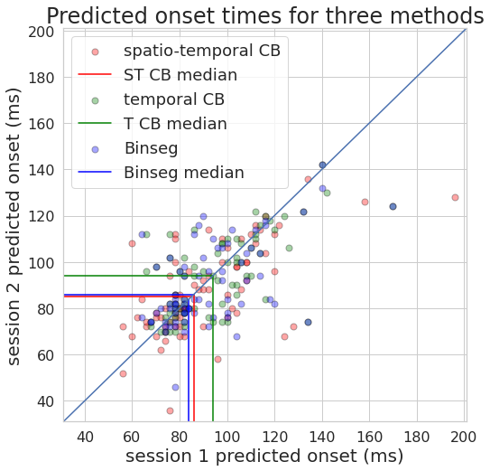
Results: onset predictions for each participant

Slide 11
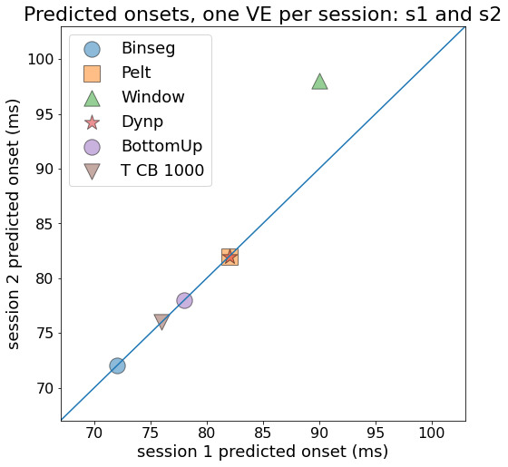
Results: ERP onset prediction for each session
Most predictions are consistent.​
Binseg predicts 72ms. ​
Temporal cluster-based predicts 76ms.​
Other CPD methods predicted later times.​

Slide 12
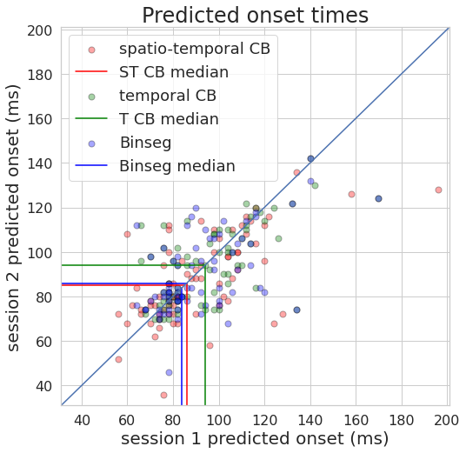
Conclusions
Virtual electrodes make onset detection easier
use the most relevant electrodes​,
reduce dimensionality and increase SNR​,
improve speed and accuracy​.
Accuracy of Binseg is similar to cluster-based methods ​
when using one virtual electrode per particpant.​
Binseg and temporal CB methods predicted earlier onset times​
when using one virtual electrode per session.​
A session virtual electrode built from max t² electrodes ​ leverages the advantages of particpant virtual electrodes.

Slide 13



Slide 14
Appendix
CPD cost functions
cost of each segment
L1: least absolute deviation.
sub = signal[start:end]
med = median(sub)
cost = abs(sub - med).sum()
L2: least squared deviation
cost = signal[start:end].var() * (end - start)
normal: Gaussian process change
sub = signal[start:end] # a vector, so use variance instead of covariance function.
var = var(sub) # just a single value, not a square matrix in this case.
val = slogdet(var) # compute the sign and natural log of the determinant of an array.
cost = val * (end-start)
rbf: Kernelized mean change
uses a gram matrix

Slide 15
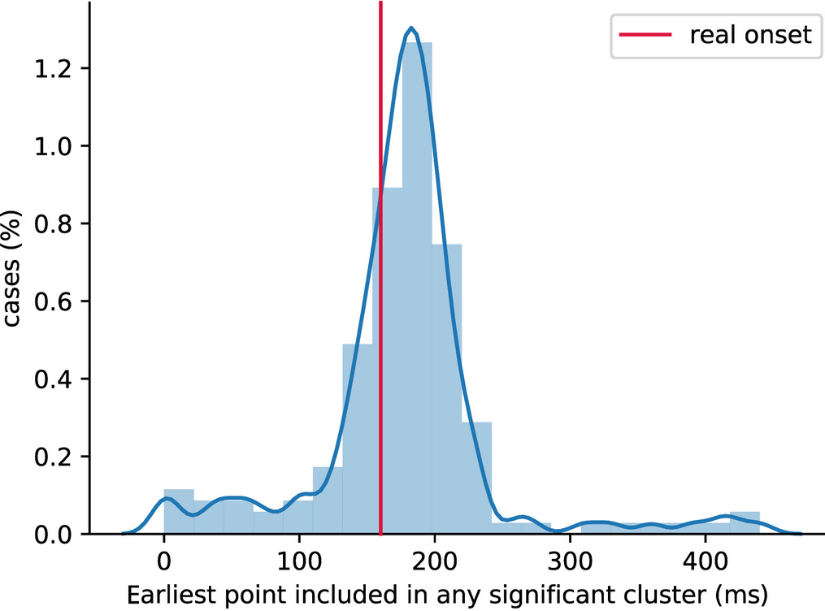
Simulations indicated low accuracy
Cluster-based onset detections, synthetic data.
Image: (Sassenhagen and Draschkow, 2019)

Slide 16
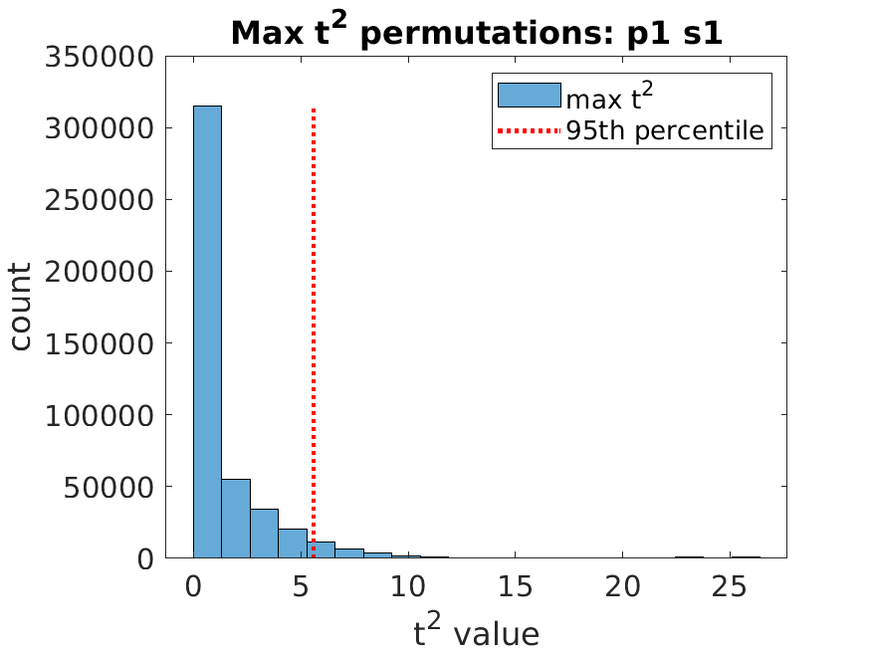
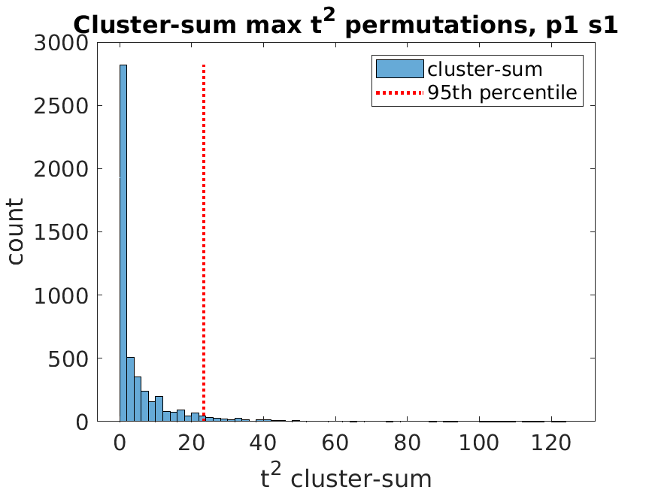
The cluster-sum method: distribution of max t² values for participant 1
dist of max t² values from permutations
dist of cluster sums
of clusters of
t² values > threshold
Distribution of t2 values for permutations of average face & texture ERPs of participant 1.
Distribution of cluster-sums t2 values for participant 1.

Slide 17
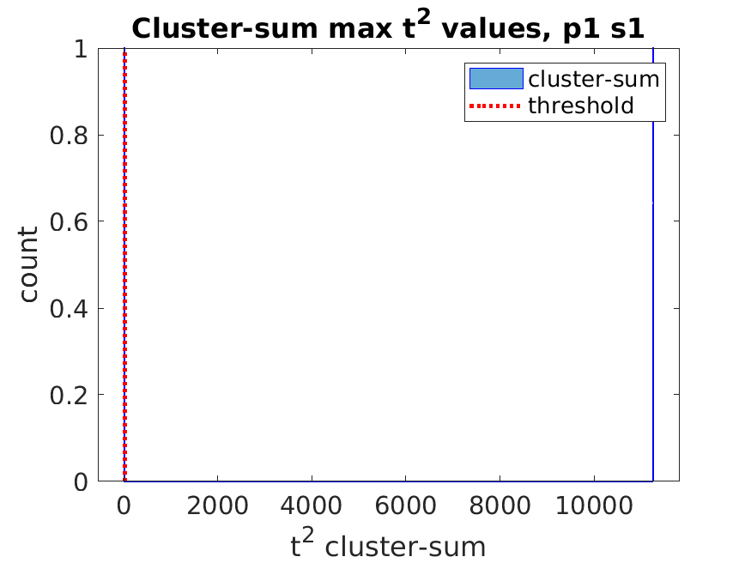
The cluster-sum method: distribution of cluster-sums for session 1
session virtual electrode
permutations of average
face & texture ERPs

Slide 18
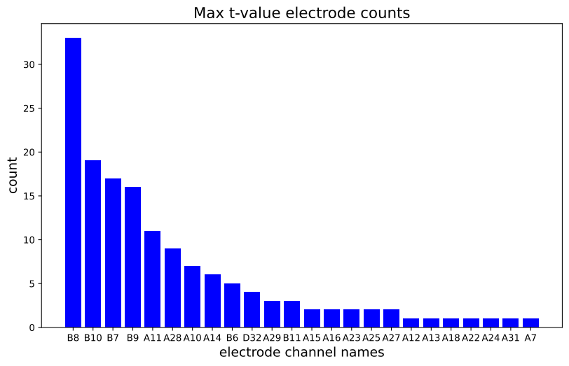
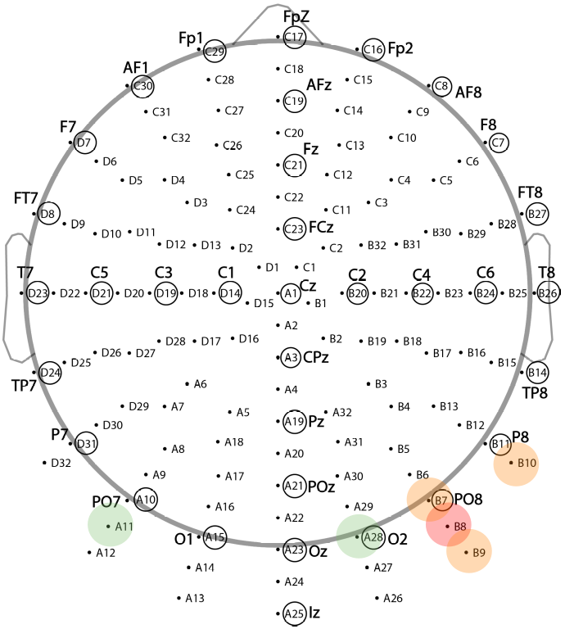
max t² electrode counts and locations
Electrode B8 was the max t² electrode 33 times.
An expected location for face sensitivity ERPs.
Top 6 are highlighted on the map:
B8=red, (B7, B9 ,B10)=orange, (A11, A28)=green.

